Slide 1
Different types of Engines
khalil Bhilal, Lazrak Yassin

Slide 2
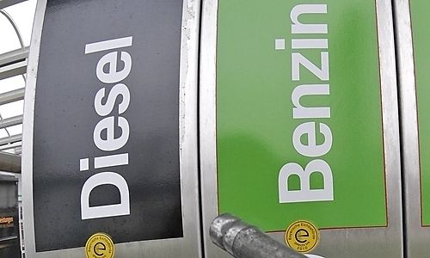
Introduction
Widespread
Economic
Ecologic

Slide 3
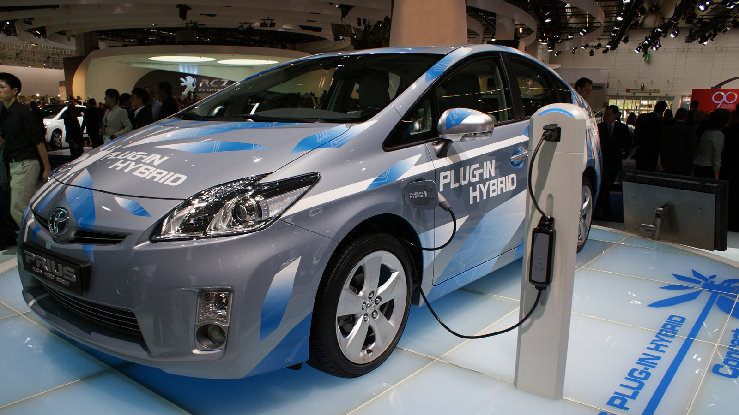
Introduction
mix of benzin engine and electric engine
Increase on the market

Slide 4
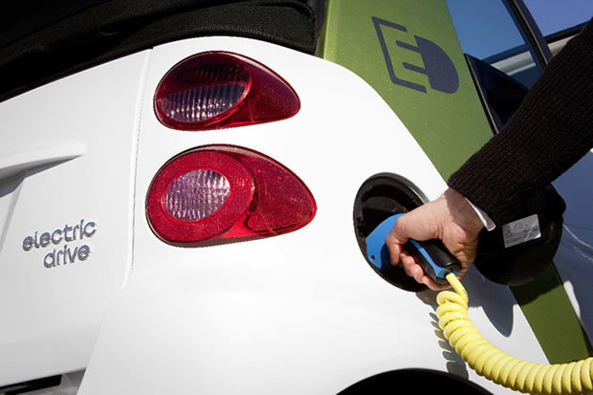
Introduction
few number
more and more in our road

Slide 5
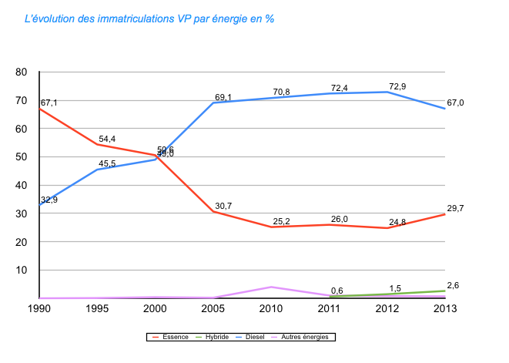
Evolution on the market

Slide 6
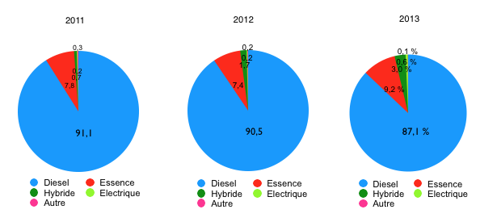
Evolution on the market

Slide 7
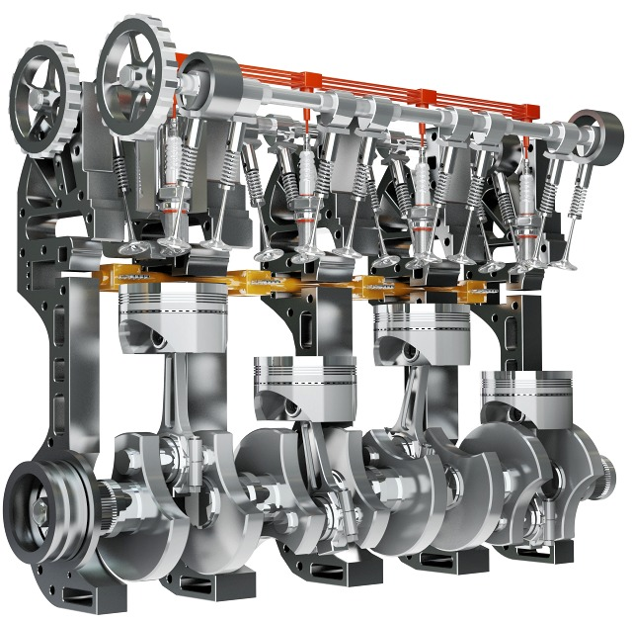
How benzin and diesel engine work
A fossil engine in a mechanical movement
Four stock
Cycle 720°

Slide 8
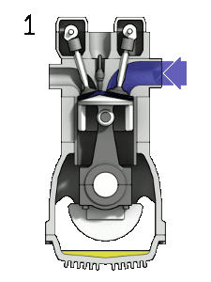
How benzin and diesel engine works
Benzin:
explosion engine
1: mix air benzin
2: compression
3: exhaust off and explosion
4: propel dawn , reject burn gaz

Slide 9
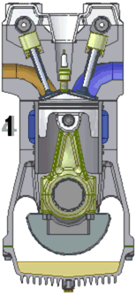
How benzin and diesel engine works
Diesel:
combustion engine
1: air
2: compression
3: exhaust in, introduction of diesel
4: propel dawn , reject burn gaz

Slide 10
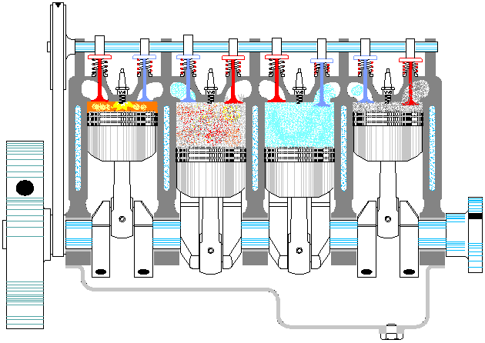
How benzin and diesel engine works
In our car

Slide 11

Difference between an engine diesel and benzin
Explosion
benzin heating more quickly than the diesel
benzin is more powerful
more noise for the benzin.
Combustion
more vibration for the diesel

Slide 12
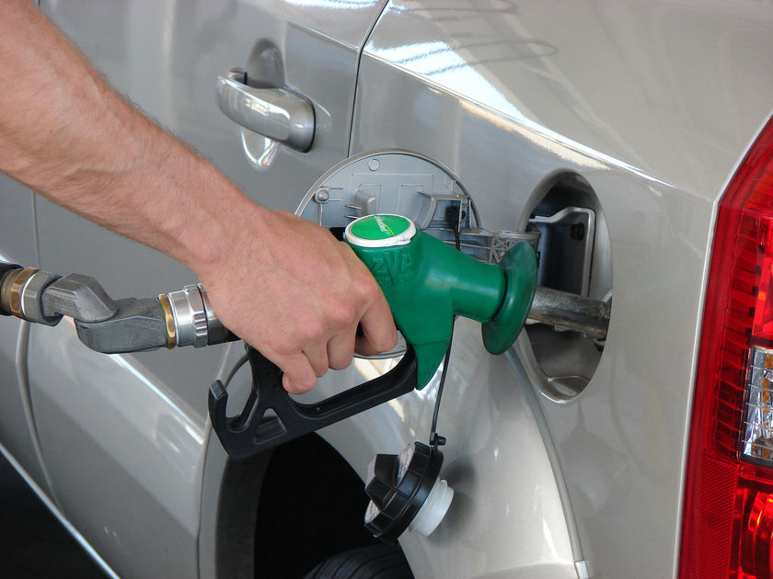
Advantage and disadvantage for the benzin
+ nervous
+ maintenance more easy
- consume more than the diesel engine
- more noise

Slide 13
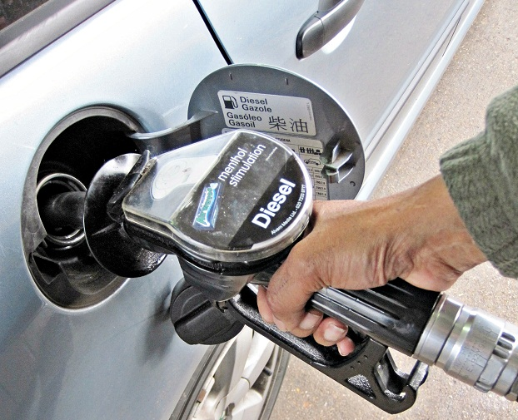
Advantage and disadvantage for the benzin
+ Economic +/-
+ Ecologies +/-
+ Less consumption
- Vibration
- less torque

Slide 14
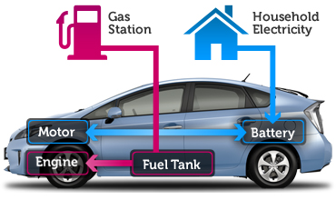
How is hybrid working ?
combination of an electric engine and benzin engine
need more power to run the diesel engine
Low torque -> Eletric engine

Slide 15
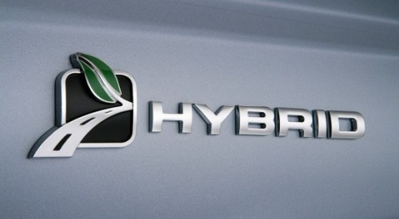
Why the hybrid ?
City drive low
Traffic Jam
Economic
Ecologic

Slide 16
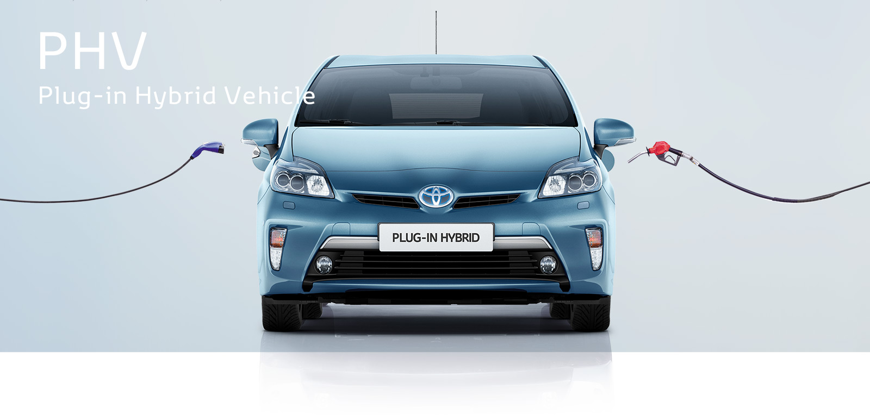
How is it working ?
depending of the model
The battery is loading with the cars, and there are models that need an extern loading (with a plug)
With the intern loading the system can load by the braking or with a generator

Slide 17
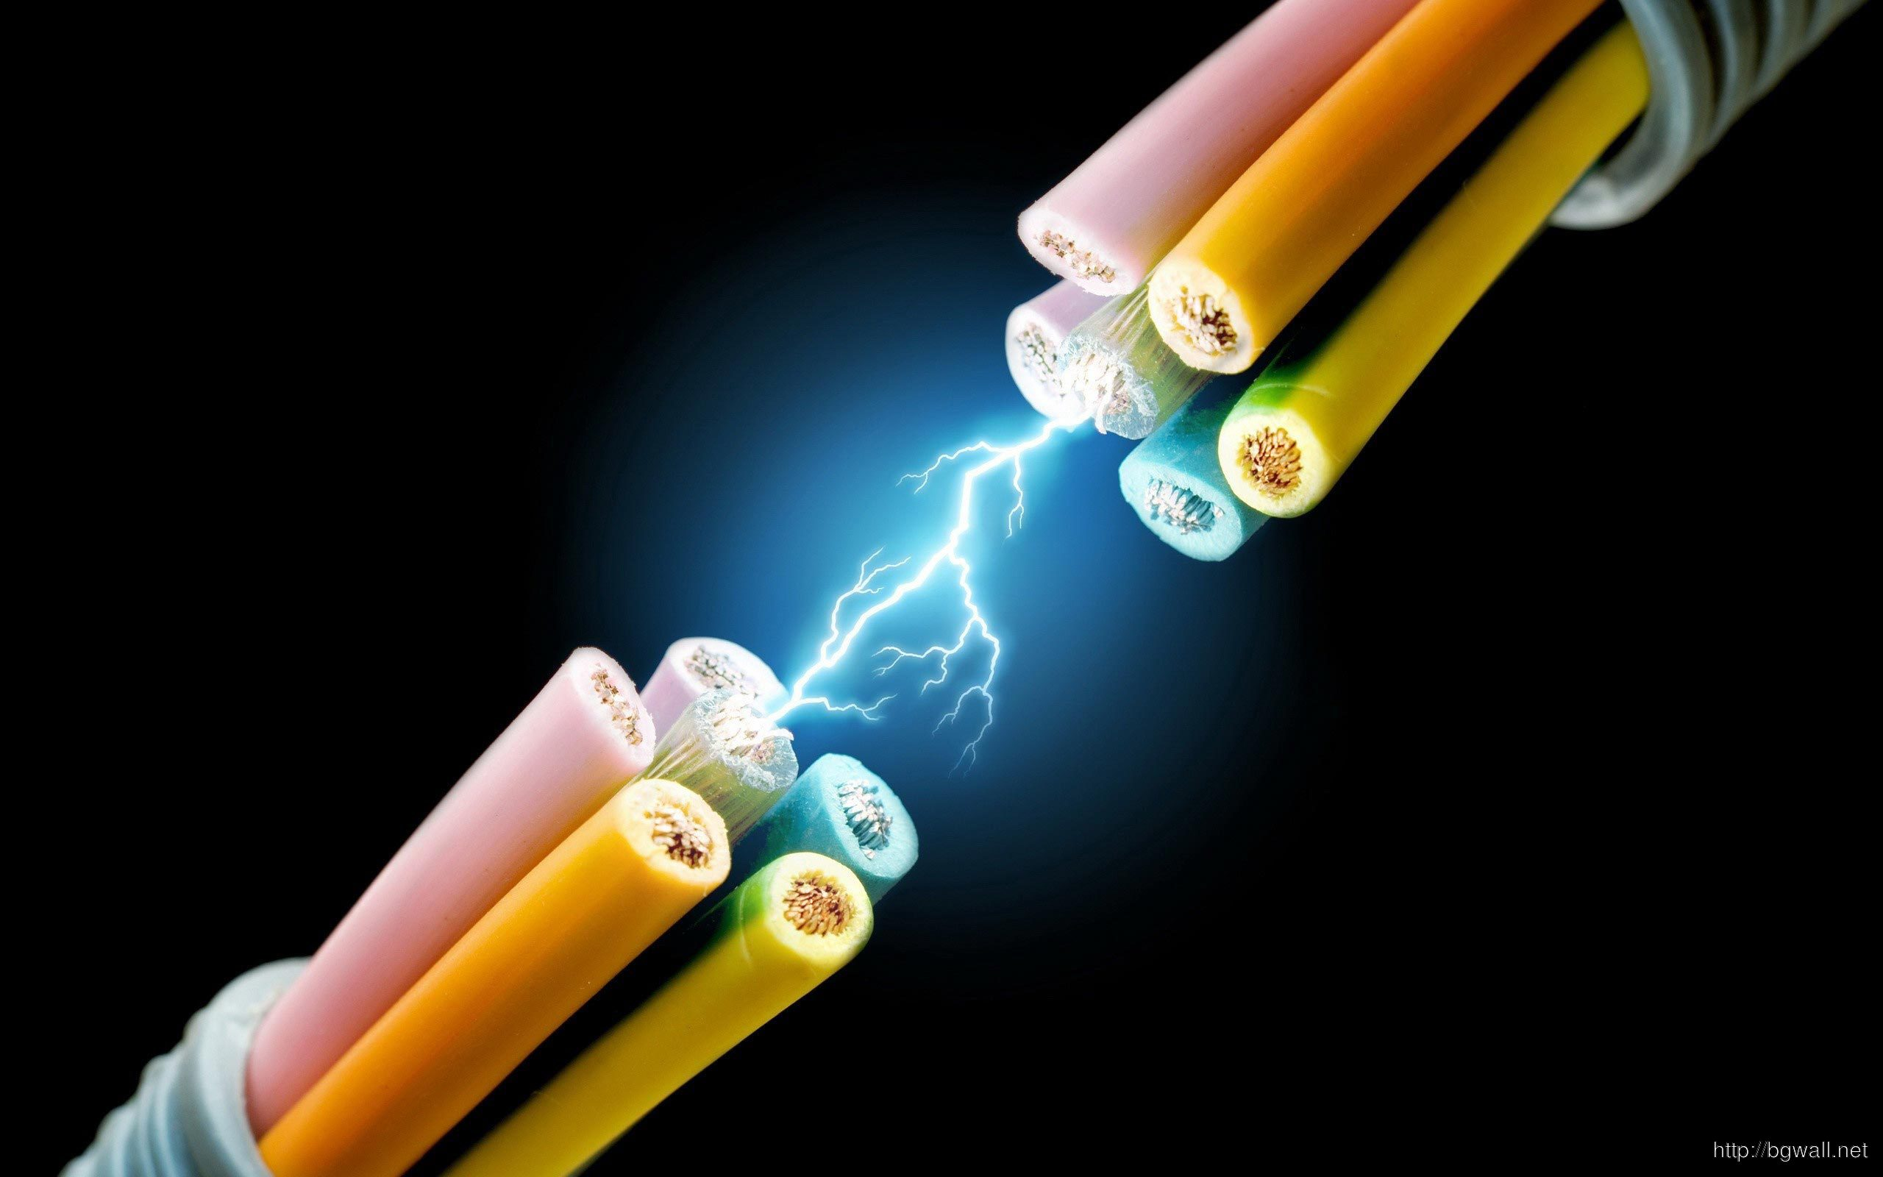
Disadvantage of the hybrid
Expensive
battery need hazardous materials (like the lithium)
reparations are expensive
Short autonomy
Mountain

Slide 18
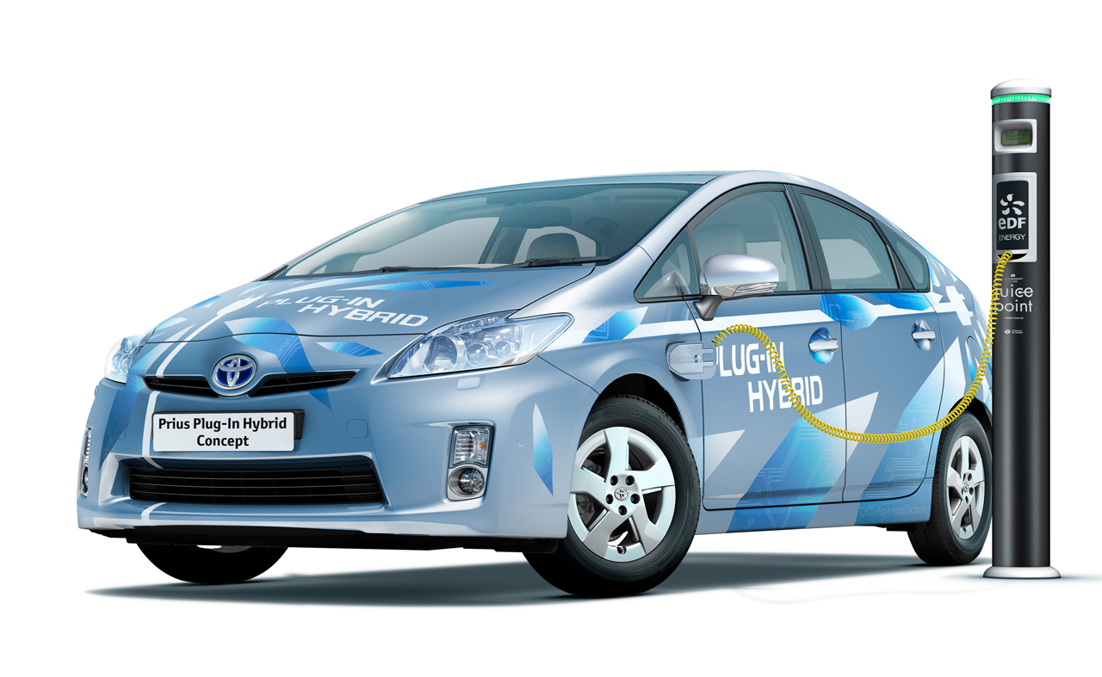
Advantage of the hybride
+- economic but the car is more expensive
+- ecologic
+ no noise and no vibration when the electric engine run
+ less tax

Slide 19

Electric

Slide 20
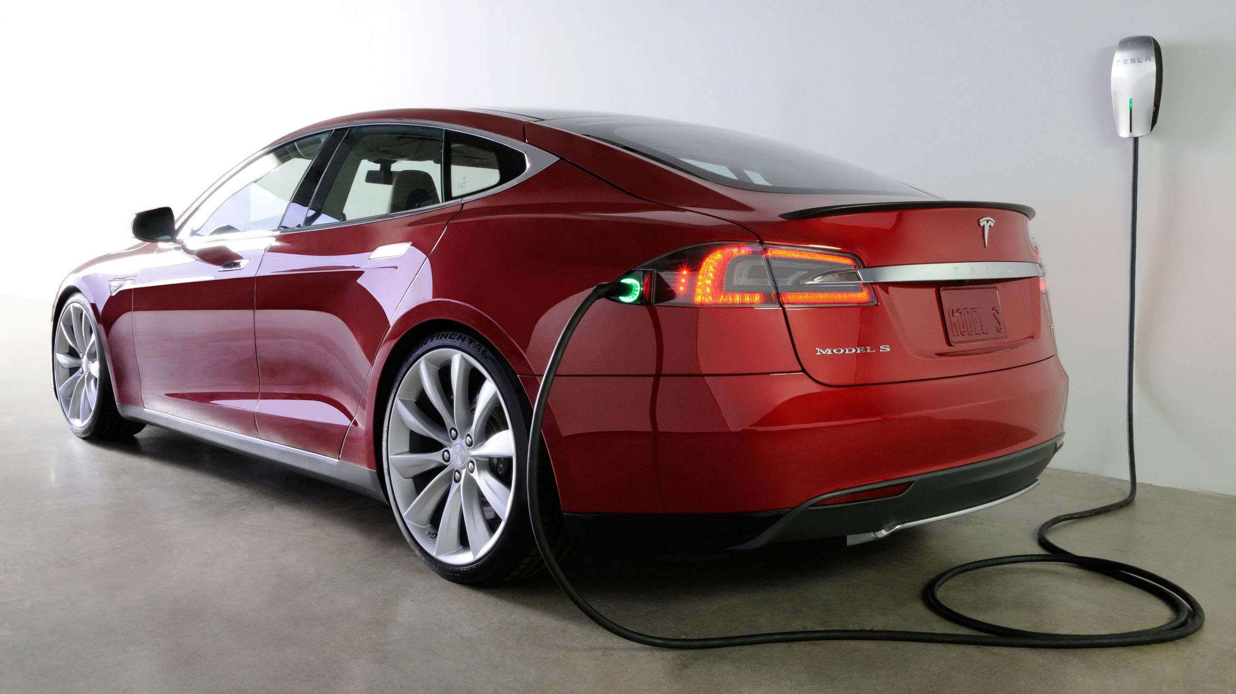
Electric engine
No noise, no vibration, the electricty is cheaper than the benzin, tax benefit.
My opinion : there is no reason to drive electric car.

Slide 21

Disadvantage of the electric
The autonomy of the battery,
need a plug for the car
the car is very expensive
the battery have hazardous material
a danger of electrocution,
Problems can happened with battery due to extreme temperature

Slide 22
Quizz
What type of energy is the F1 using ?
Which type of vehicle cost the most in case of a problem ?
Which type of engine make noise ?

Slide 23
Conclusion
It depends on the budget’s client.
Some people care about Environment.
For sensation, drive pleasure -> Diesel & Gaz.
Diesel cost less than Gaz but they are more expansive.
Hybrid put 2 points of view together, price and environment.

Slide 24
Video
https://www.youtube.com/watch?v=-9kgvIIcKTc

